Slide 1
Web Analytics

Slide 2
Introduction
Web analytics is the collection, reporting, and analysis of website data. The focus is on identifying measures based on your organizational and user goals and using the website data to determine the success or failure of those goals and to drive strategy and improve the user’s experience.

Slide 3
Basic steps of the web analytics process
Collection of data:
  This stage is the collection of the basic, elementary data. Usually, these data are counts of things. The objective of this stage is to gather the data.
Processing of data into information:
  This stage usually take counts and make them ratios, although there still may be some counts. The objective of this stage is to take the data and conform it into information, specifically metrics.
Developing KPI:
  This stage focuses on using the ratios (and counts) and infusing them with business strategies, referred to as Key performance indicators(KPI). Many times, KPIs deal with conversion aspects, but not always. It depends on the organization.

Slide 4
Cont...
Formulating online strategy:
  This stage is concerned with the online goals, objectives, and standards for the organization or business. These strategies are usually related to making money, saving money, or increasing market-share.
Another essential function developed by the analysts for the optimization of the websites are the experiments
  Experiments and testings: A/B testing is a controlled experiment with two variants, in online settings, such as Web development.

Slide 5
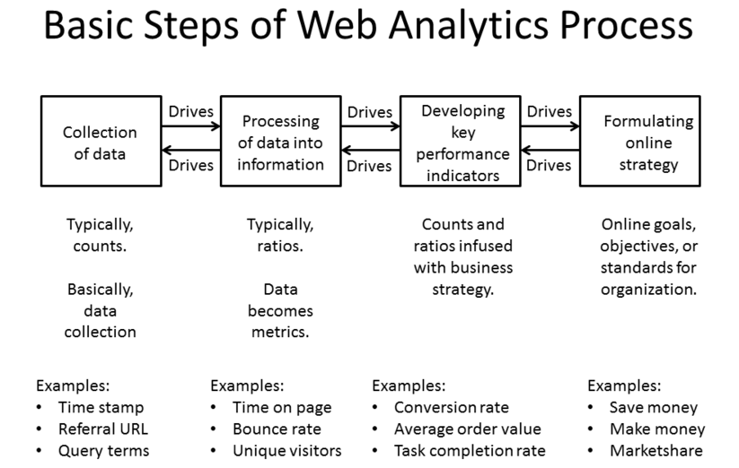

Slide 6
Web analytics technologies
Off-site web analytics
  refers to web measurement and analysis regardless of whether you own or maintain a website. It includes the measurement of a website's potential audience (opportunity), share of voice (visibility), and buzz (comments) that is happening on the Internet as a whole.
On-site web analytics,
  the more common of the two, measure a visitor's behavior once on your website. This includes its drivers and conversions; for example, the degree to which different landing pages are associated with online purchases. On-site web analytics measures the performance of your website in a commercial context. This data is typically compared against KPI for performance and is used to improve a website or marketing campaigns audience response.

Slide 7
What is Google Analytics used for?
Google Analytics is one of the most popular digital analytics software.
It is Google's free web analytics service that allows you to analyze in-depth detail about the visitors on your website.
It provides valuable insights that can help you to shape the success strategy of your business.

Slide 8
What is Google Analytics?
Google Analytics is a platform for collecting, analyzing, and presenting web site usage statistics

Slide 9
Brief history of web traffic analysis
Web server applications generate logs that record every web request
In the ‘90s, a closet industry of freeware and commercial log file analyzers blossomed
Log file analyzers would read through your (sometimes huge) log files and spit out reports of which pages were most popular, where visitors came from, and other useful information
Log file analyzers became part of the standard webmaster’s toolkit

Slide 10
How Google Analytics is different
Google Analytics does not require any access to any webserver
Out of the box, GA provides extremely useful information with no special configuration whatsoever
GA’s reports are highly interactive and encourage discovery
The amount of information captured in GA is extremely robust and constantly evolving

Slide 11
How Google Analytics works
A Google Analytics JavaScript snippet is placed on your web page
When the page is read by the browser, the JavaScript sends information about the visit to Google’s servers, where it is recorded
Alternatively, JavaScript can be written that deliberately sends information to Google servers about web page interactions that don’t involve reading a page, such as starting a video or scrolling

Slide 12
How Google Analytics works
Website administrators can allow anyone with a Google Account to view their statistics and interact with reports
Google Analytics users can navigate through interactive reports
Reports can be exported as PDFs
Google Analytics users can create custom Dashboards that provide at-a-glance data of interest

Slide 13
What can Google Analytics track?
The JavaScript sends:
URL requested
Time of visit
Previous URL
Visitor’s unique identifier
Visitor’s network name/domain
Any known Google User Profile information
Technical details about the visitor’s device
  Browser make/model/version
  Operating system

Slide 14
From that, Google Analytics can derive …
Whether the visit came from a mobile device (from OS)
Duration of visit (from time of visit)
Whether the request was an “entry” or an “exit” (from previous page)
Visitor’s location (from network/domain)
Whether the visitor is new or returning (from unique identifier)
Whether the user was directed to your page from a search engine (from previous page)
  What search term the user used to find your page

Slide 15
What can’t Google Analytics track?
PDF, image, and other file downloads
  The JavaScript that triggers the data send has to be read from an HTML page. If no HTML page is read, no data is sent.
Where the user goes when they leave your site
  If the user requests a page that doesn’t have your Google Analytics snippet on it (e.g., someone else’s page), data is not sent to your Google Analytics data bucket.

Slide 16
Google Analytics vocabulary
Dimension
A non-quantitative piece of data that Google Analytics collects and displays. E.g., visitor’s city (“Paris), visitor’s operating system (“Microsoft Windows”).
Metric
A quantitative piece of data that Google Analytics displays, which is usually a derived value. E.g., “Number of hits per day.” “Number of pages per session.”

Slide 17
Google Analytics vocabulary
Pageview
A single completed request for a web page on your site.
Visit
A series of Pageviews (or other recorded activity) by a particular user within a particular period of time. If a user views page A, then page B, then page C, then leaves your site, that’s one Visit.
Visitor
An end user that interacts with your site. Each Visitor is given a unique but meaningless ID from Google that identifies them within Google Analytics.

Slide 18
Google Analytics vocabulary
Acquisition
Generally used to describe how a user got to your site. Did they use a search engine? Did they click on an ad?
Behavior
Generally used to describe what a user does once they get to your site. Did they request a particular page? Did they trigger an Event?
Events
Particular, pre-defined interactions that a Visitor has with your site that is not a Pageview.

Slide 19
Commonly reported statistics in monthly reports
Number of Visits
Number of Pageviews
Pageviews per Visit
Number of Visitors
New/Returning Visitor ratio
% of traffic coming from Yale networks
Top pages as % of total Pageviews
Top pages navigated to from the home page
Top browser make/model/versions
Everything above, but scoped only to mobile visitors

Slide 20
Summary
Google Analytics is primarily geared toward for-profit websites that are selling something. Many of the constructs in Google Analytics, such as Conversions, Goals, and ad traffic analysis are therefore designed to help sites sell something.
This makes it difficult for mission-based organizations relate to
The trick is to ask yourself “what am I selling?” What on your website translates to “payday?” Downloading a brochure? Having a research question answered? Clicking a link to a campus map? What is the ultimate goal of your website, and what specific, measurable Visitor interaction means success?

